Slide 1


COMMISSIONER CABINET
Monthly Training

Slide 2
JACK BOYDE
District Commissioner
The Commissioner Role with Youth Protection

Slide 3
Notes:
The personal safety of all youth is of paramount importance to the Boy Scouts of America. Child abuse and neglect,
whether in Scouting or in the community at large, affect everyone.
The BSA focuses on protecting youth through the implementation of comprehensive prevention policies, early detection of child abusers, and meaningful intervention to stop abuse and assist victims.
The BSA reminds us that Youth Protection Begins With You™. As a commissioner, you have a vital responsibility to implement and communicate the BSA’s Youth Protection policies.

Slide 4

Youth Protection and the Commissioner
Ways to Help:
Monitor status of YPT leaders
Annual Youth Protection Visit
Assist with Leader Selection Process
Inform leaders of reporting responsibility
Notes:
OVERVIEW of the Commissioner Role – will go into detail for each point on slides that follow.

Slide 5
Youth Protection and the Commissioner
Ways to Help:
Promote use of YP tools
Encourage participation in YP month
Explain use of YP inserts
Keep current on rules & tools
Notes:
OVERVIEW of the Commissioner Role – will go into detail for each point on slides that follow.

Slide 6
Youth Protection and the Commissioner
Monitor Status of YP-trained leaders
Remind unit leaders/committee chairs of the requirement
Must be renewed every two years
Online tools available to check training status
Notes:
REMEMBER: New leaders have 30 days to complete YPT!

Slide 7

Notes:
OF COURSE – registered leaders are required to get trained…
STRONGLY ENCOURAGE parents, sponsoring organization reps and other to take the training.
(especially parents who actively participate in unit events)

Slide 8
Youth Protection and the Commissioner
Annual Youth Protection Visit
Meeting of adults (unit committee)
Held each fall (usually November)
Review latest training tools
(booklets, videos, etc.)
Encourage unit to show video(s)
Notes:
Part of The Annual Commissioner Service Plan (Chapter 6 – 33621 Fieldbook)

Slide 9
Youth Protection and the Commissioner
Assist With Leader Selection
Explain Charter Organization role
Encourage active reference checks
Provide telephone reference checklists
Notes:
Leadership Requirements
The applicant must possess the moral, educational, and emotional qualities that the Boy Scouts of America deems necessary to afford positive leadership to youth. The applicant must also be the correct age, subscribe to the precepts of the Declaration of Religious Principle, and abide by the Scout Oath or Promise, and the Scout Law.
Following approval by the unit committee chairman, all other adult unit members must be approved by the head of the chartered
organization or the chartered organization representative.

Slide 10
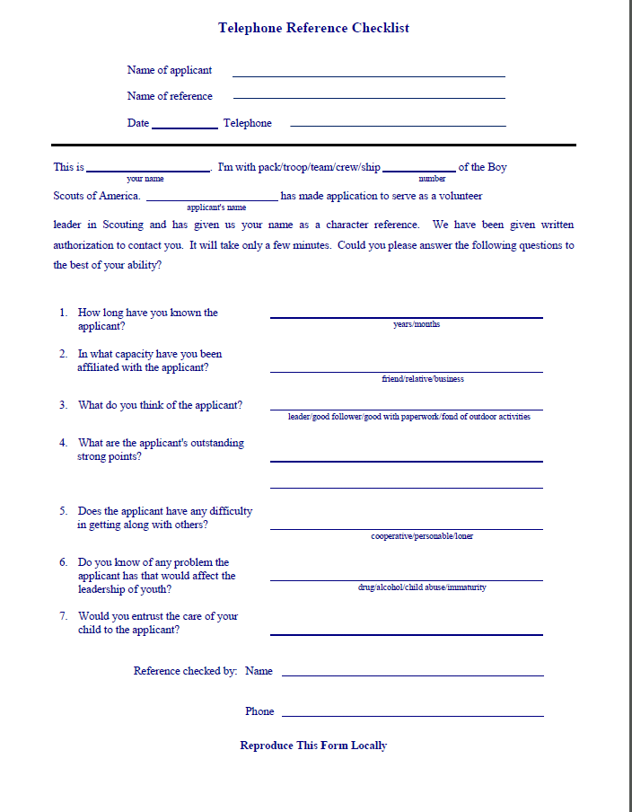
Notes:
Refer to handout.
PDF available on Commissioner-bsa.org for download.

Slide 11
Youth Protection and the Commissioner
Inform/Educate About Reporting Responsibility
IMMEDIATE reporting
Seek guidance as necessary
Be careful!
Notes:
Whether youth come into our programs from abusive households, are bullied in school, are exposed to explicit material in their community or online, or are sexually abused, even in Scouting, we must take immediate action.
You and the person bringing a suspected incident to your attention must immediately report to the authorities any good-faith suspicion or belief that any child is or has been physically or sexually abused, physically or emotionally neglected, exposed to any form of violence or threat, or exposed to any form of sexual exploitation, including the possession, manufacture, or distribution of child pornography; online solicitation; enticement; or showing of obscene material.
You and the person reporting must report the information immediately to the authorities for investigation. The BSA’s mandatory reporting policy on child abuse is clear—No person may abdicate this reporting responsibility to any other person.
Notify your Scout executive of this report, or of any violation may take appropriate action for the safety of our Scouts, make appropriate notifications, and follow-up with investigating agencies.

Slide 12
Youth Protection and the Commissioner
Basic Information Needed
Who is involved?
What happened?
Where did it occur?
Are there witnesses or others with info?
How did you come to know of the violation?
What did you do about it?
Notes:
What basic information needs to be included in the report to the Scout executive and to law enforcement?

Slide 13
Youth Protection and the Commissioner
Promote Use of YP Tools
On line training Sessions
  Two levels.
Videos
  Time to Tell
  It Happened To Me
  Personal Safety Awareness
Notes:
On line training Sessions
Two levels. (Scouts & Venturing)
Videos
Time to Tell
It Happened To Me
Personal Safety Awareness

Slide 14
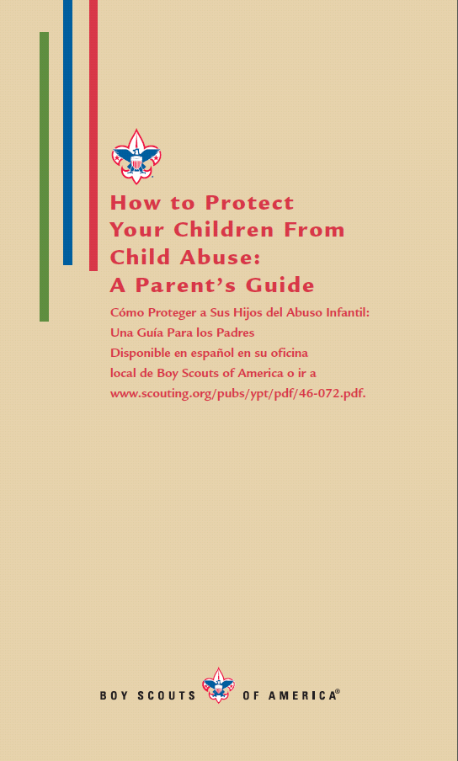
Youth Protection and the Commissioner
Explain use of YP inserts
Teach unit leaders how
boy and parent use inserts
Make sure material is
reviewed during the SM
Conference when boy
joins Troop
Notes:
Explain to unit adult leaders how a boy and his parents use the inserts in the front of the youth handbooks
AND the importance of including a review of this material during the Scoutmaster conference when a boy joins the troop.

Slide 15


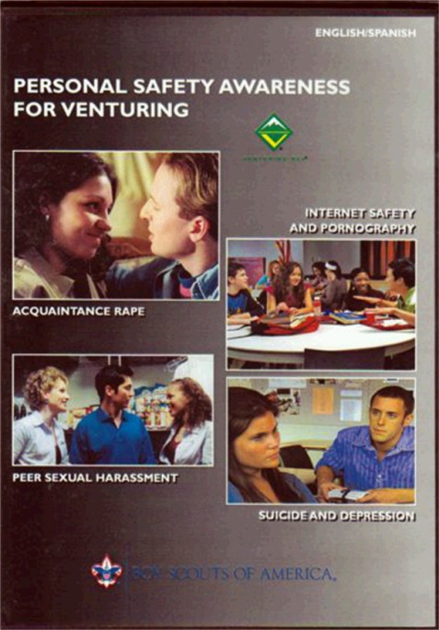
Youth Protection and the Commissioner
Make Sure Units have Latest Version!
Notes:
Videos are constantly being updated.
Make sure your units are using the latest version.

Slide 16

Youth Protection and the Commissioner
Promote Use of YP Tools
Cyber Chip
  Youth should carry like Totin’ Chip, etc.
  www.scouting.org/CyberChip
  Card & Patches available
  June is Internet Safety Month
Notes:
TEACH YOUR UNITS about the Cyber Chip
The Cyber Chip joins the Totin’ Chip and Whittling Chip as important safety tools your Scouts should earn and carry with them
http://www.scouting.org/CyberChip

Slide 17

Youth Protection and the Commissioner
Promote Bullying Awareness
Information
  http://scouting.org/Training/YouthProtection/bullying
  October is Bullying Prevention Month
Notes:
TEACH YOUR UNITS to be aware of bullying prevention!

Slide 18

Youth Protection and the Commissioner
Questions?

Slide 19


